Slide 1




Erasmus+ JEAN MONNET NETWORK
“GOVERNANCE, PLURALISM & TRANS-NATIONALISATION IN EUROPE”
Place: University of Luxembourg, Limpertsberg Campus
Title:
Academic Sessions (Workshop)
“Governance and Sovereignty in Europe”
Doctoral Winter School
16/12/2017
Decision-making procedure et legitimation
Professor: Foteini Asderaki
Team members: Andreas Gkolfinopoulos, University of Siegen
Eleftheria Terzoudi, University of the Aegean
Fréderic Albert, University of Luxembourg
Maria Geroulia, University of the Aegean

Slide 2
The European Commission within an institutional “trap”:
Banning glyphosate or banning EU-citizens’ initiative?
Research Question: Does the European citizens’ initiative enhance European Commissions’ relations
with citizens
Hypothesis 1: EU as a “window of opportunity” for the establishment of continuous communication channels
with the citizens
Hypothesis 2: Opposition from the member states restraints the relation between
the European Commission and the citizens and shifts the blame game towards the commission
Theory: European Governance: Supranational negotiation in the “Shadow of hierarchy” (Börzel, 2010)
Methodology:

Slide 3

The European Commission within an institutional “trap”:
Banning glyphosate or banning EU-citizens’ initiative?
-> European citizens’initiative “Ban Glyphosate and Protect People and the Environment from Toxic Pesticides”
*The quicker answer, until then
European Commissions’ answer points:
“The approval or non-approval of substances such as glyphosate falls under the Commission's implementing powers under the Plant Protection Products Regulation. “
o
Maximum in EU legislation:
15 years
10 years
Finally, renewal of the approval:
5 years

Slide 4
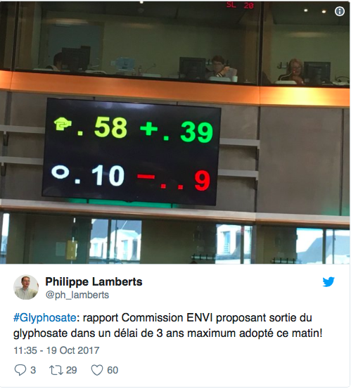
European Commissions’ answer points:
3. the Commission has taken into account possibilities of rapid future developments in science and technology
4. can, at any time, review the approval of glyphosate if new scientific evidence emerges that indicates that the substance no longer fulfils the approval criteria
5. the Commission has no basis to submit to the co-legislators a proposal
to ban glyphosate
6. However, Member States have the obligation to evaluate
all authorisations for glyphosate-containing plant protection products
and may decide to introduce restrictions or bans for some
or all of them where this is warranted
on the basis of evidence related to the particular circumstances
in their territories.

Slide 5
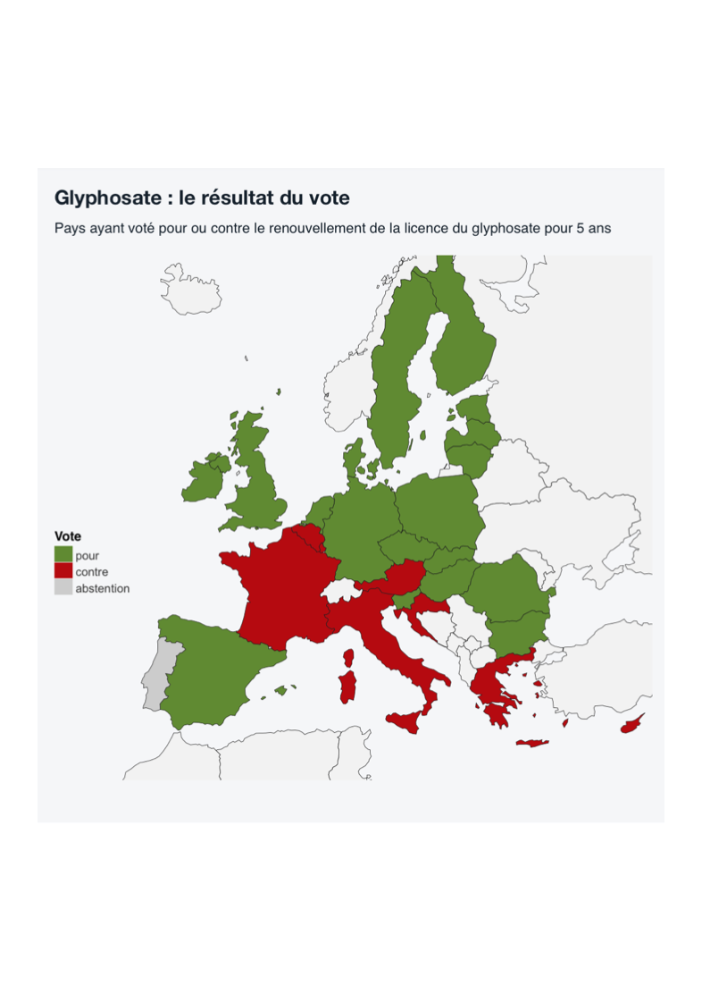

Slide 6
But the recent revelations in the ‘Monsanto Papers’ have thrown doubt on the reliability of the European findings. The documents, now declassified in the United States, show that EFSA’s 2015 study is largely copy-pasted from an earlier study by Monsanto, the biggest marketer of glyphosate through its best-selling weed killer Roundup, according to The Guardian.

